Slide 1

WP10
WP10: AI Accelerated Materials Discovery
KIT
BIG-MAP Biannual Meeting, April 20-21, 2022
This project has received funding from the European Union’s Horizon 2020 research
and innovation programme under grant agreement No 957189.

Slide 2
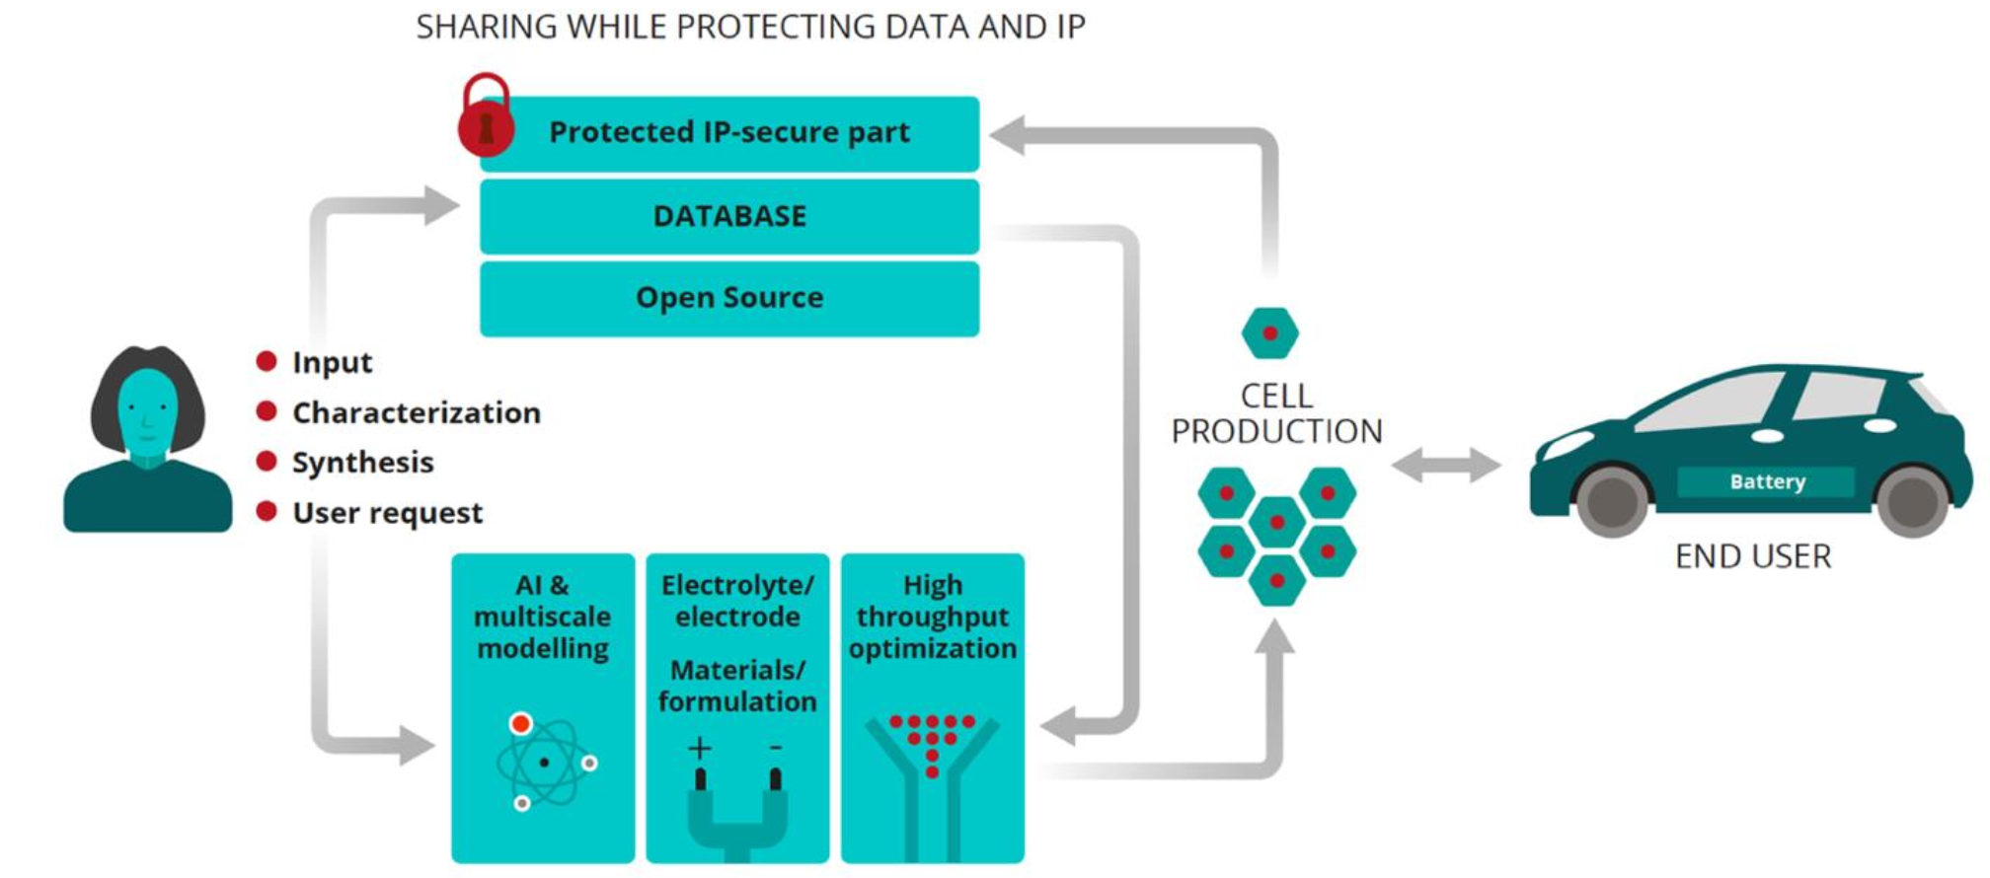

WP10 in a BIG-MAP

Slide 3



WP Tasks and Deliverables
Accelerating experiments with active learning
An automated data analysis framework
WP4,WP5, WP6
WP4,WP5, WP6
WP11, WP2, WP3, WP4,WP5, WP6
WP2, WP3, WP4, WP5, WP6, WP11
Transfer learning and new fundamental insights
Automatic reasoning and materials funnel
D10.1: Active learning Package/Module (KIT, M18) D10.2: Modular package for analysis (ULIV, M24)
D10.3: Demonstration of linking active learning accelerated HTS and simulations (DTU, M24) D10.4: Tiered theory and experiment screening pipeline (KIT, M36)

Slide 4




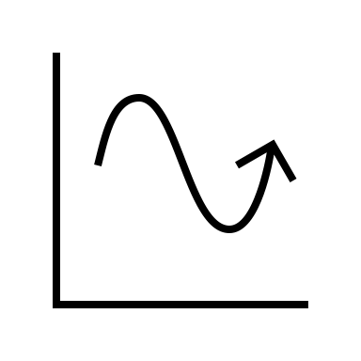
Contribution to specific objectives and targeted KPIs at M18
Accelerating experiments with active learning
WP4,WP5, WP6
WP2, WP3, WP4, WP5, WP6, WP11
Automatic reasoning and materials funnel
WP4,WP5, WP6
An automated data analysis framework
WP4,WP5, WP6
Transfer learning and new fundamental insights
WP11

Slide 5
Highlights of the work
In the first period (M1-M18), the work in WP10 has aimed to:
Create a modular framework for lab automation
Create an active learning server
Deploy joint experiments and theory pipelines
Started work for automated data analysis

Slide 6
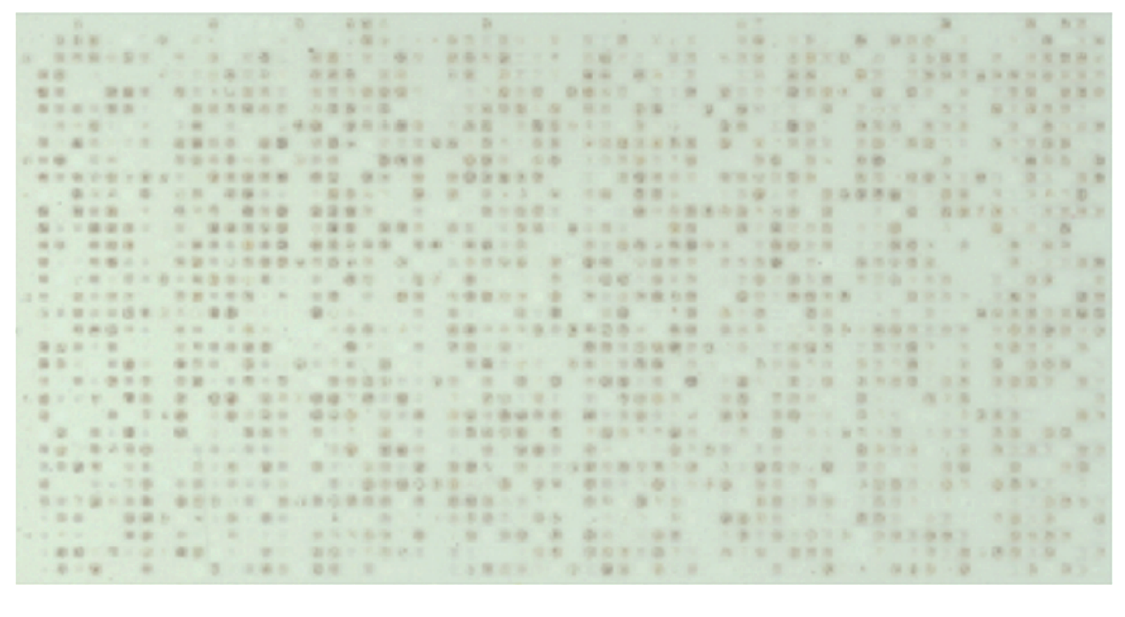
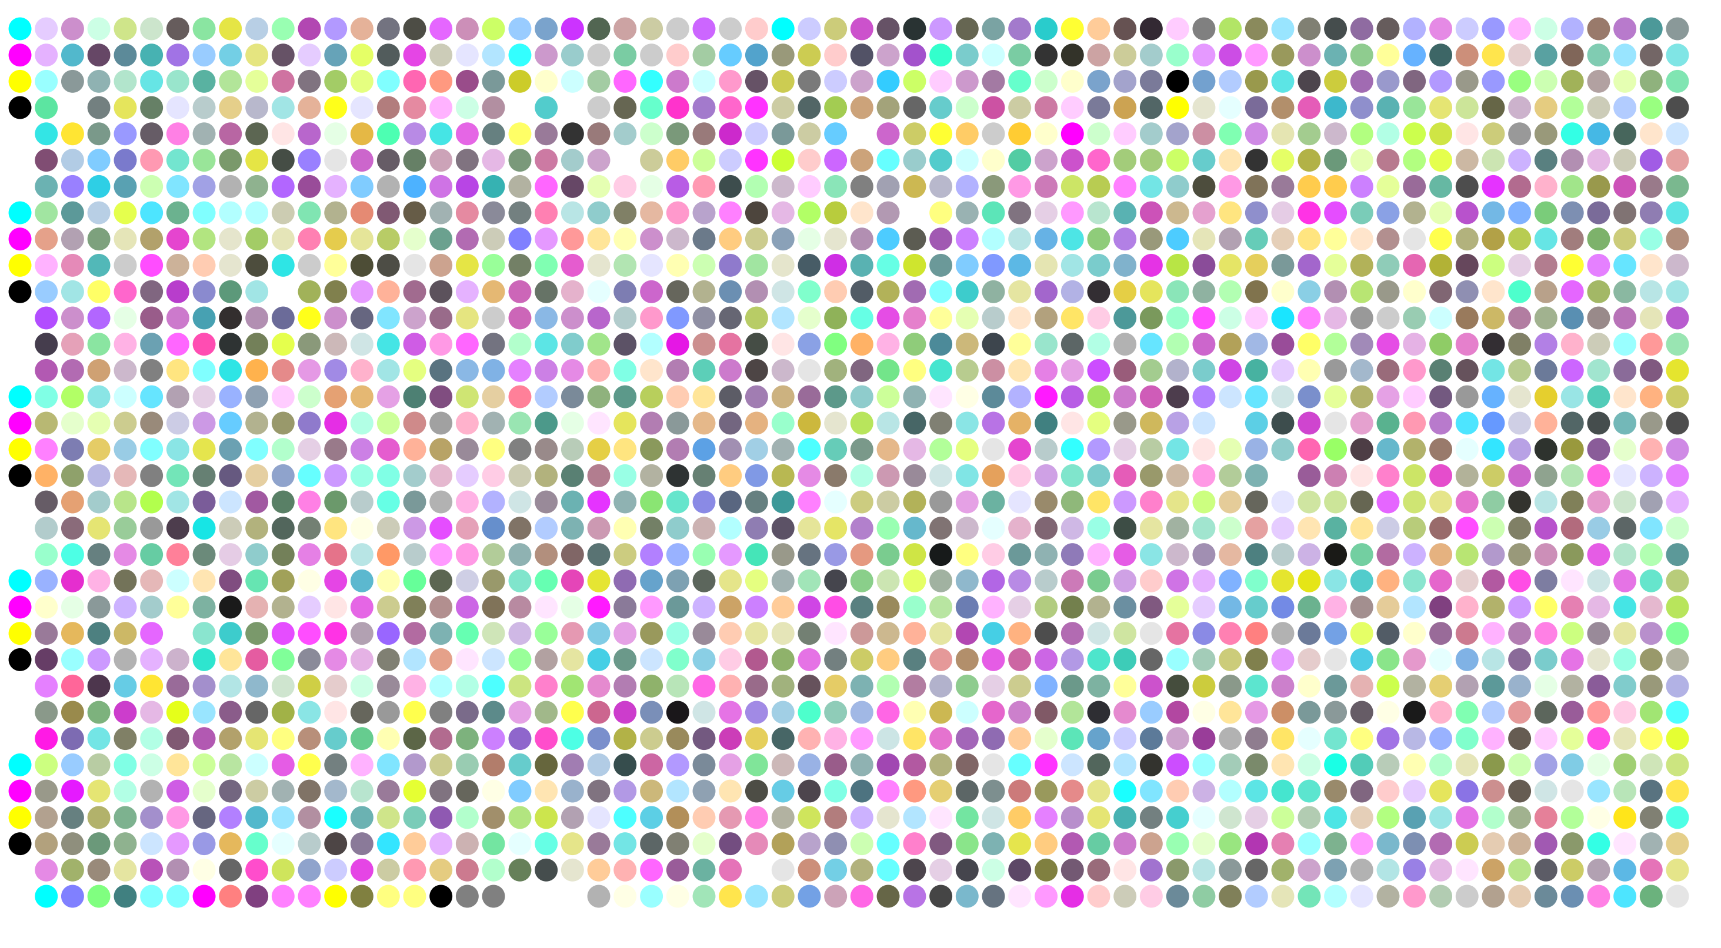
Highlights of the work: HELAO
Say HELAO to autonomous labs!
Implications of the BATTERY 2030+ AI-Assisted Toolkit on Future Low-TRL Battery Discoveries and Chemistries Arghya Bhowmik, Maitane Berecibar,Montse Casas-Cabanas,Gabor Csanyi,Robert Dominko,Kersti Hermansson,M. Rosa Palacin,Helge S. Stein,Tejs Vegge, Advanced Energy Materials, 2021, accepted/ early view
Enabling Modular Autonomous Feedback-Loops in Materials Science through Hierarchical Experimental Laboratory Automation and Orchestration Advanced Interface Materials, F. Rahmanian et al., 2021, early access

Slide 7
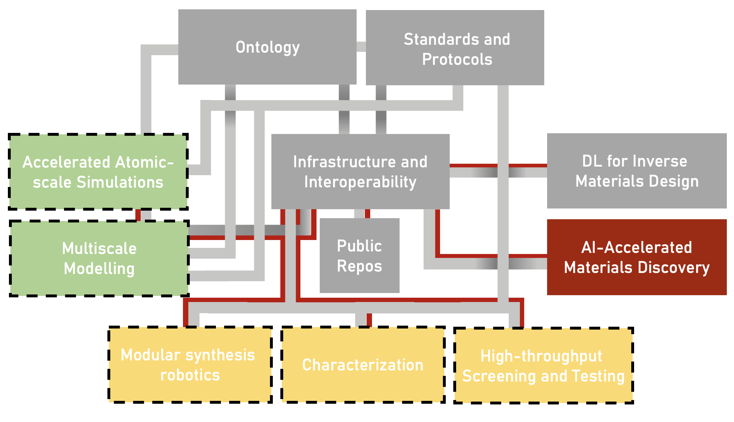
Highlights of the work: HELAO
Say HELAO to autonomous labs!
Implications of the BATTERY 2030+ AI-Assisted Toolkit on Future Low-TRL Battery Discoveries and Chemistries Arghya Bhowmik, Maitane Berecibar,Montse Casas-Cabanas,Gabor Csanyi,Robert Dominko,Kersti Hermansson,M. Rosa Palacin,Helge S. Stein,Tejs Vegge, Advanced Energy Materials, 2021, accepted/ early view
Enabling Modular Autonomous Feedback-Loops in Materials Science through Hierarchical Experimental Laboratory Automation and Orchestration Advanced Interface Materials, F. Rahmanian et al., 2021, early access

Slide 8

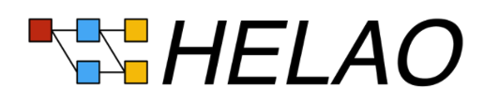
Highlights of the work: HELAO
Say HELAO to autonomous labs!
Implications of the BATTERY 2030+ AI-Assisted Toolkit on Future Low-TRL Battery Discoveries and Chemistries Arghya Bhowmik, Maitane Berecibar,Montse Casas-Cabanas,Gabor Csanyi,Robert Dominko,Kersti Hermansson,M. Rosa Palacin,Helge S. Stein,Tejs Vegge, Advanced Energy Materials, 2021, accepted/ early view
Enabling Modular Autonomous Feedback-Loops in Materials Science through Hierarchical Experimental Laboratory Automation and Orchestration Advanced Interface Materials, F. Rahmanian et al., 2021, early access

Slide 9
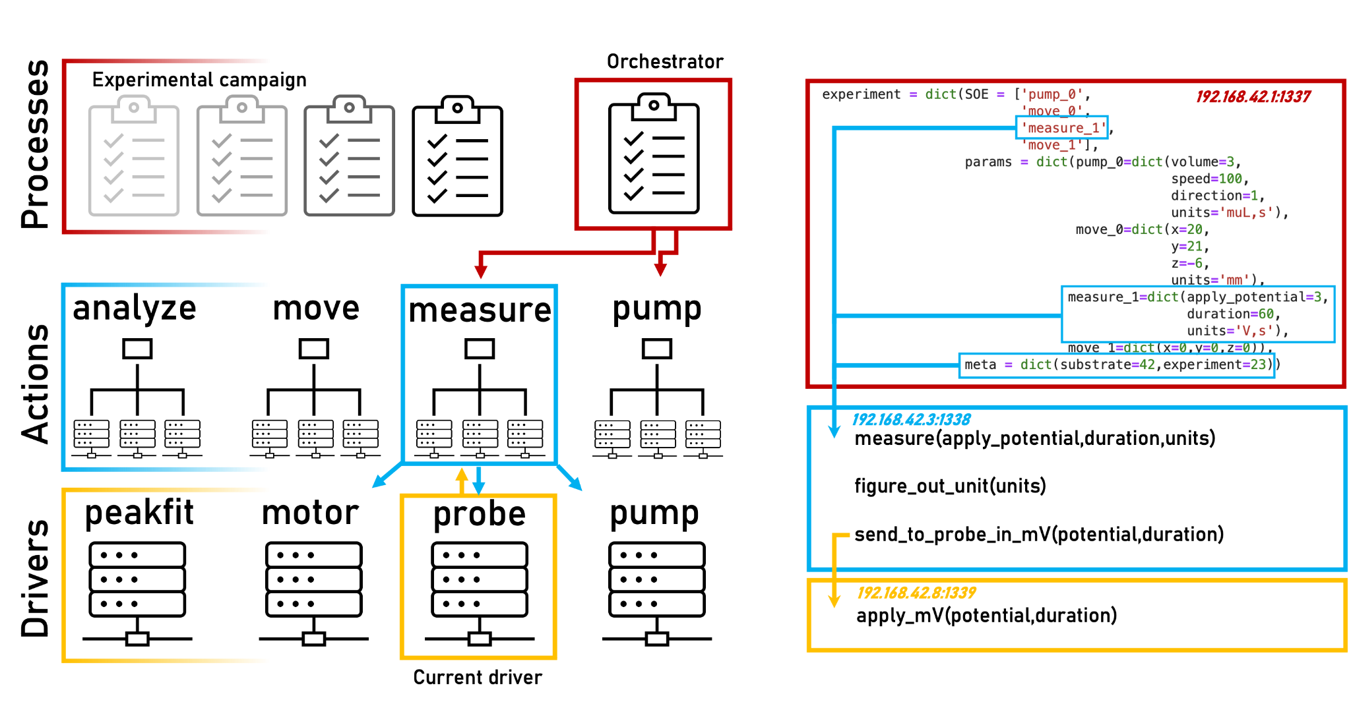
Highlights of the work: HELAO
Say HELAO to autonomous labs!
Enabling Modular Autonomous Feedback-Loops in Materials Science through Hierarchical Experimental Laboratory Automation and Orchestration, Advanced Interface Materials, F. Rahmanian et al., 2021,

Slide 10
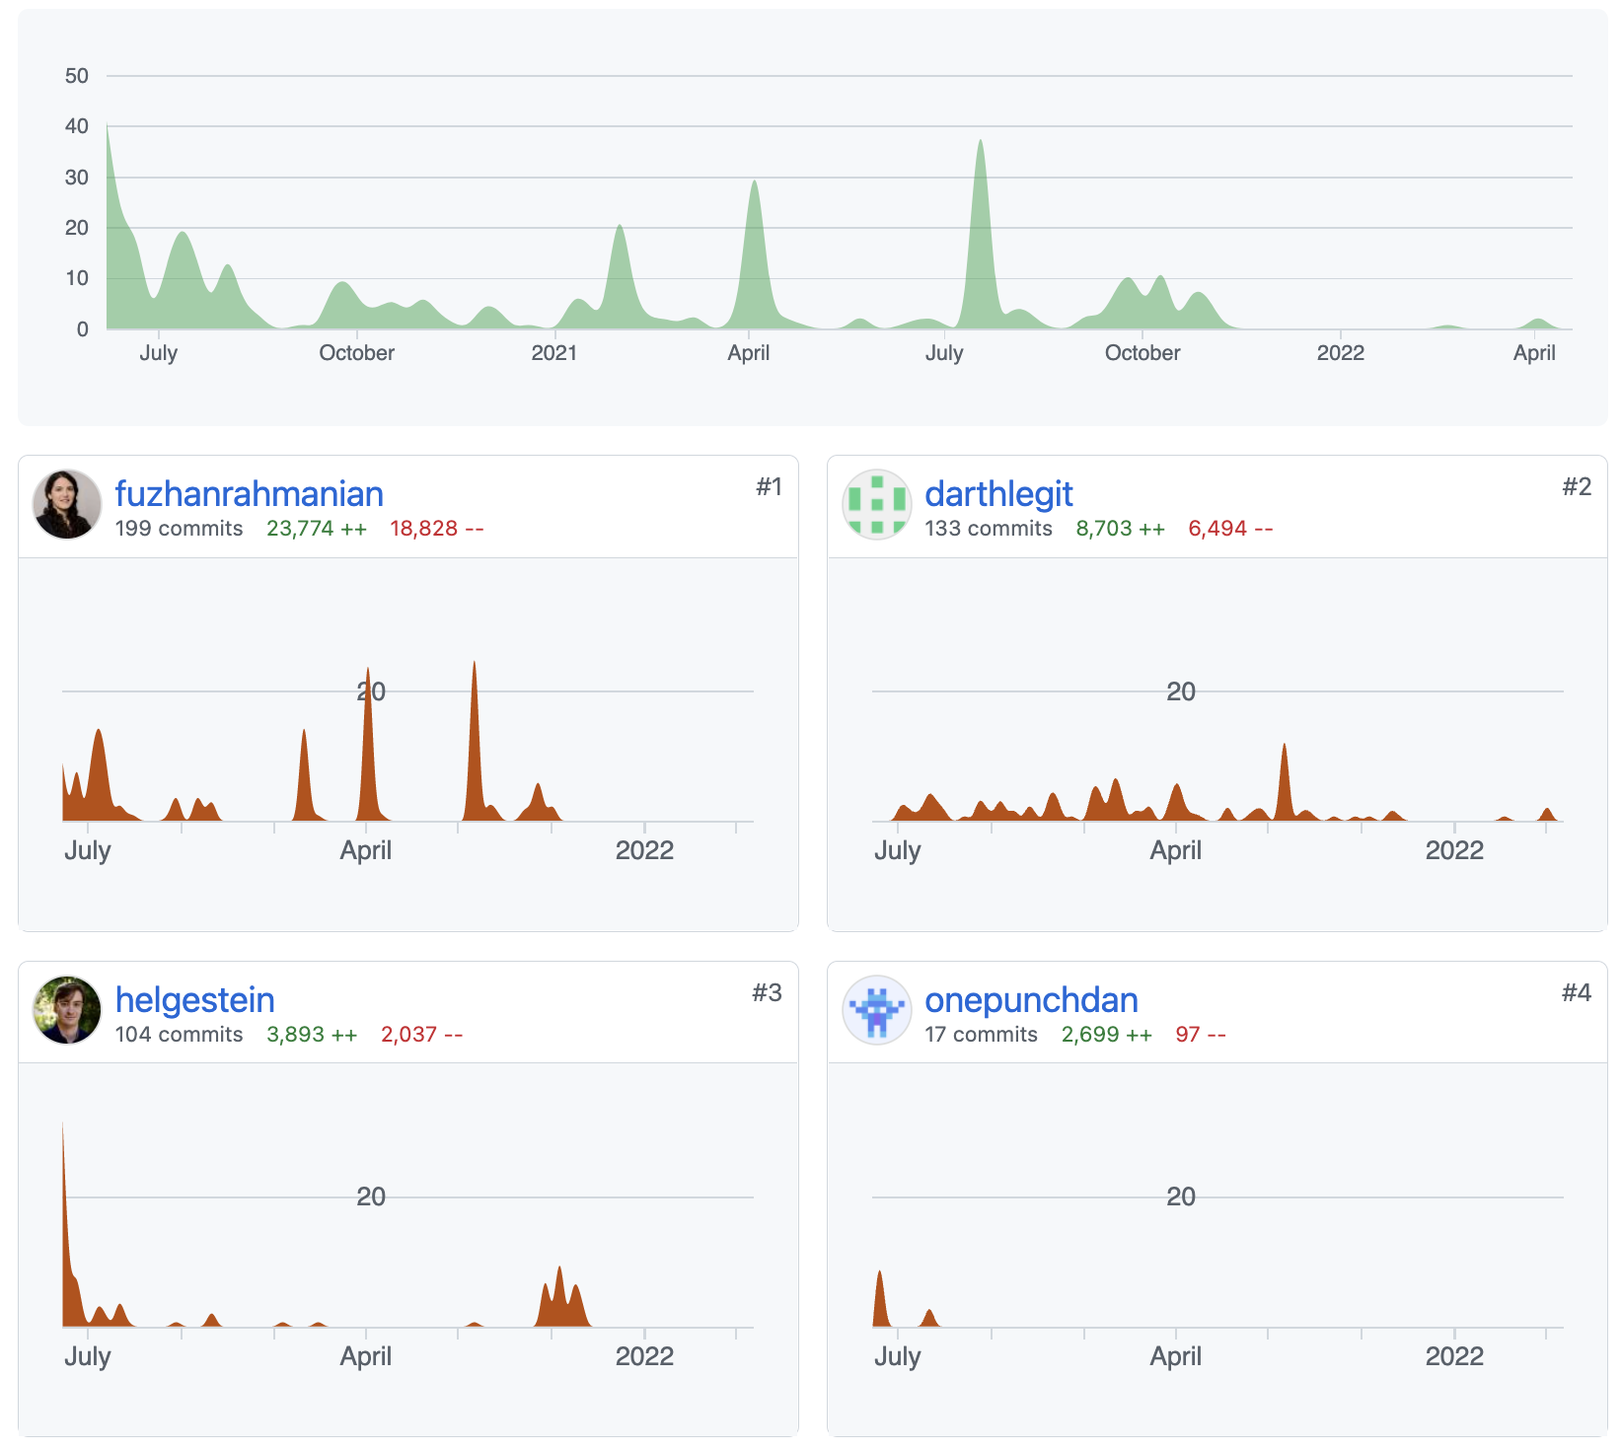
Highlights of the work: HELAO
Say HELAO to autonomous labs!
Enabling Modular Autonomous Feedback-Loops in Materials Science through Hierarchical Experimental Laboratory Automation and Orchestration, Advanced Interface Materials, F. Rahmanian et al., 2021,

Slide 11
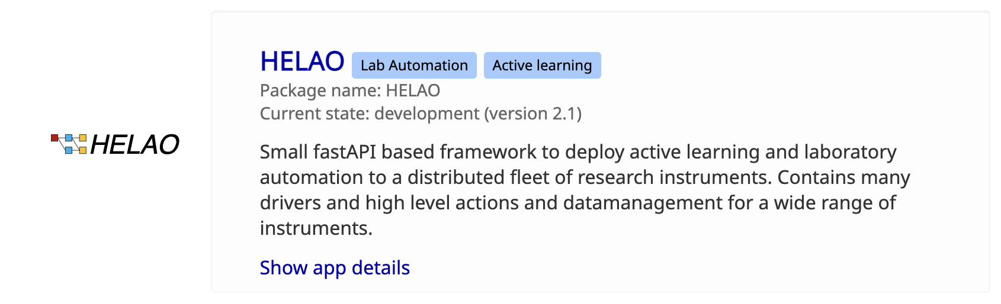
Highlights of the work: HELAO
Say HELAO to autonomous labs!
Enabling Modular Autonomous Feedback-Loops in Materials Science through Hierarchical Experimental Laboratory Automation and Orchestration, Advanced Interface Materials, F. Rahmanian et al., 2021,

Slide 12
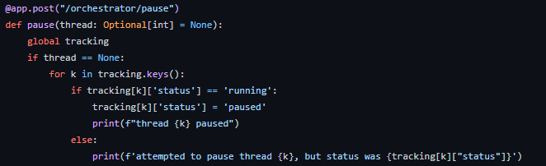
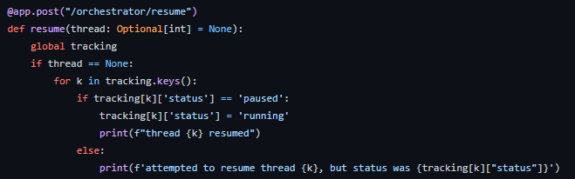
Highlights of the work: HELAO
Say HELAO to autonomous labs!
Enabling Modular Autonomous Feedback-Loops in Materials Science through Hierarchical Experimental Laboratory Automation and Orchestration, Advanced Interface Materials, F. Rahmanian et al., 2021,

Slide 13
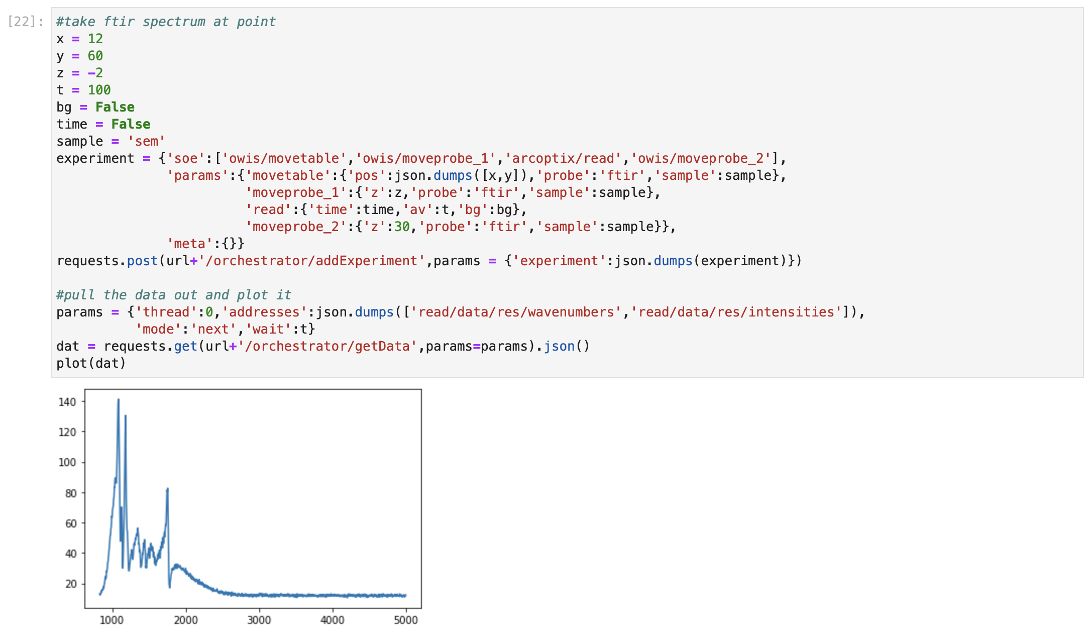
Highlights of the work: HELAO
Say HELAO to autonomous labs!
Enabling Modular Autonomous Feedback-Loops in Materials Science through Hierarchical Experimental Laboratory Automation and Orchestration, Advanced Interface Materials, F. Rahmanian et al., 2021,

Slide 14


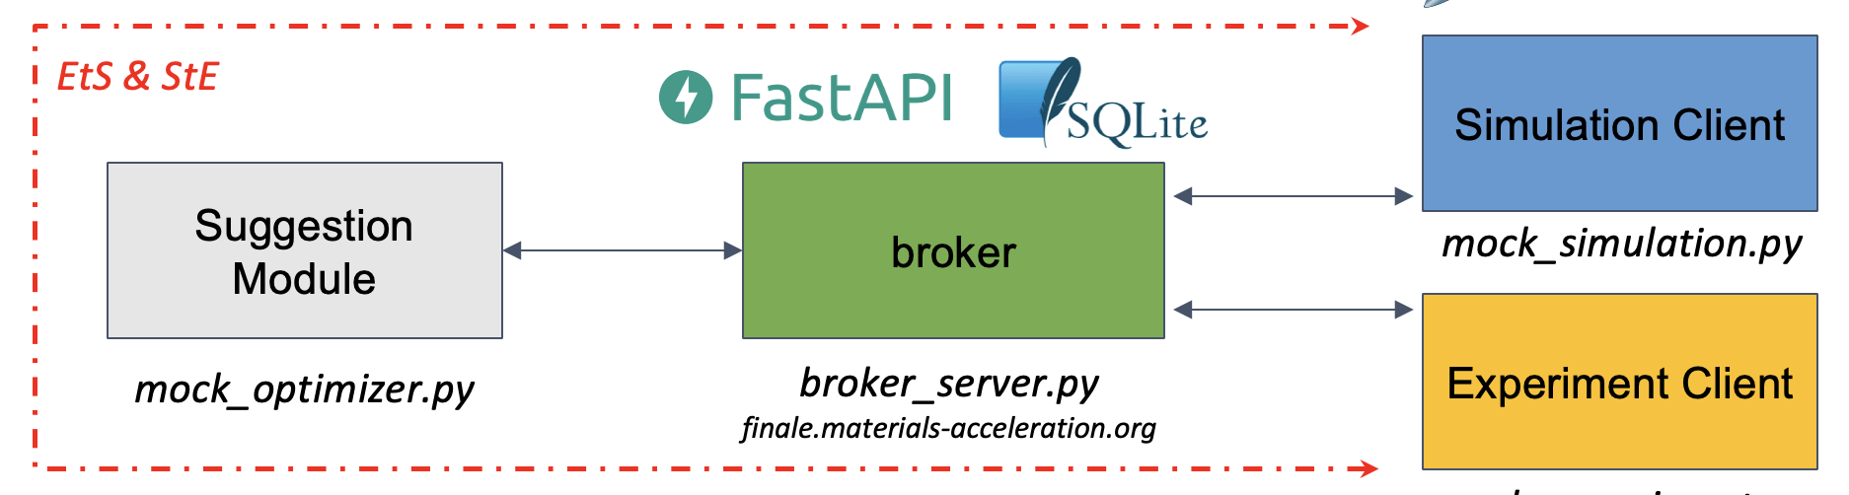

Highlights of the work: AL beyond one lab
Say HELAO to autonomous labs!

Slide 15
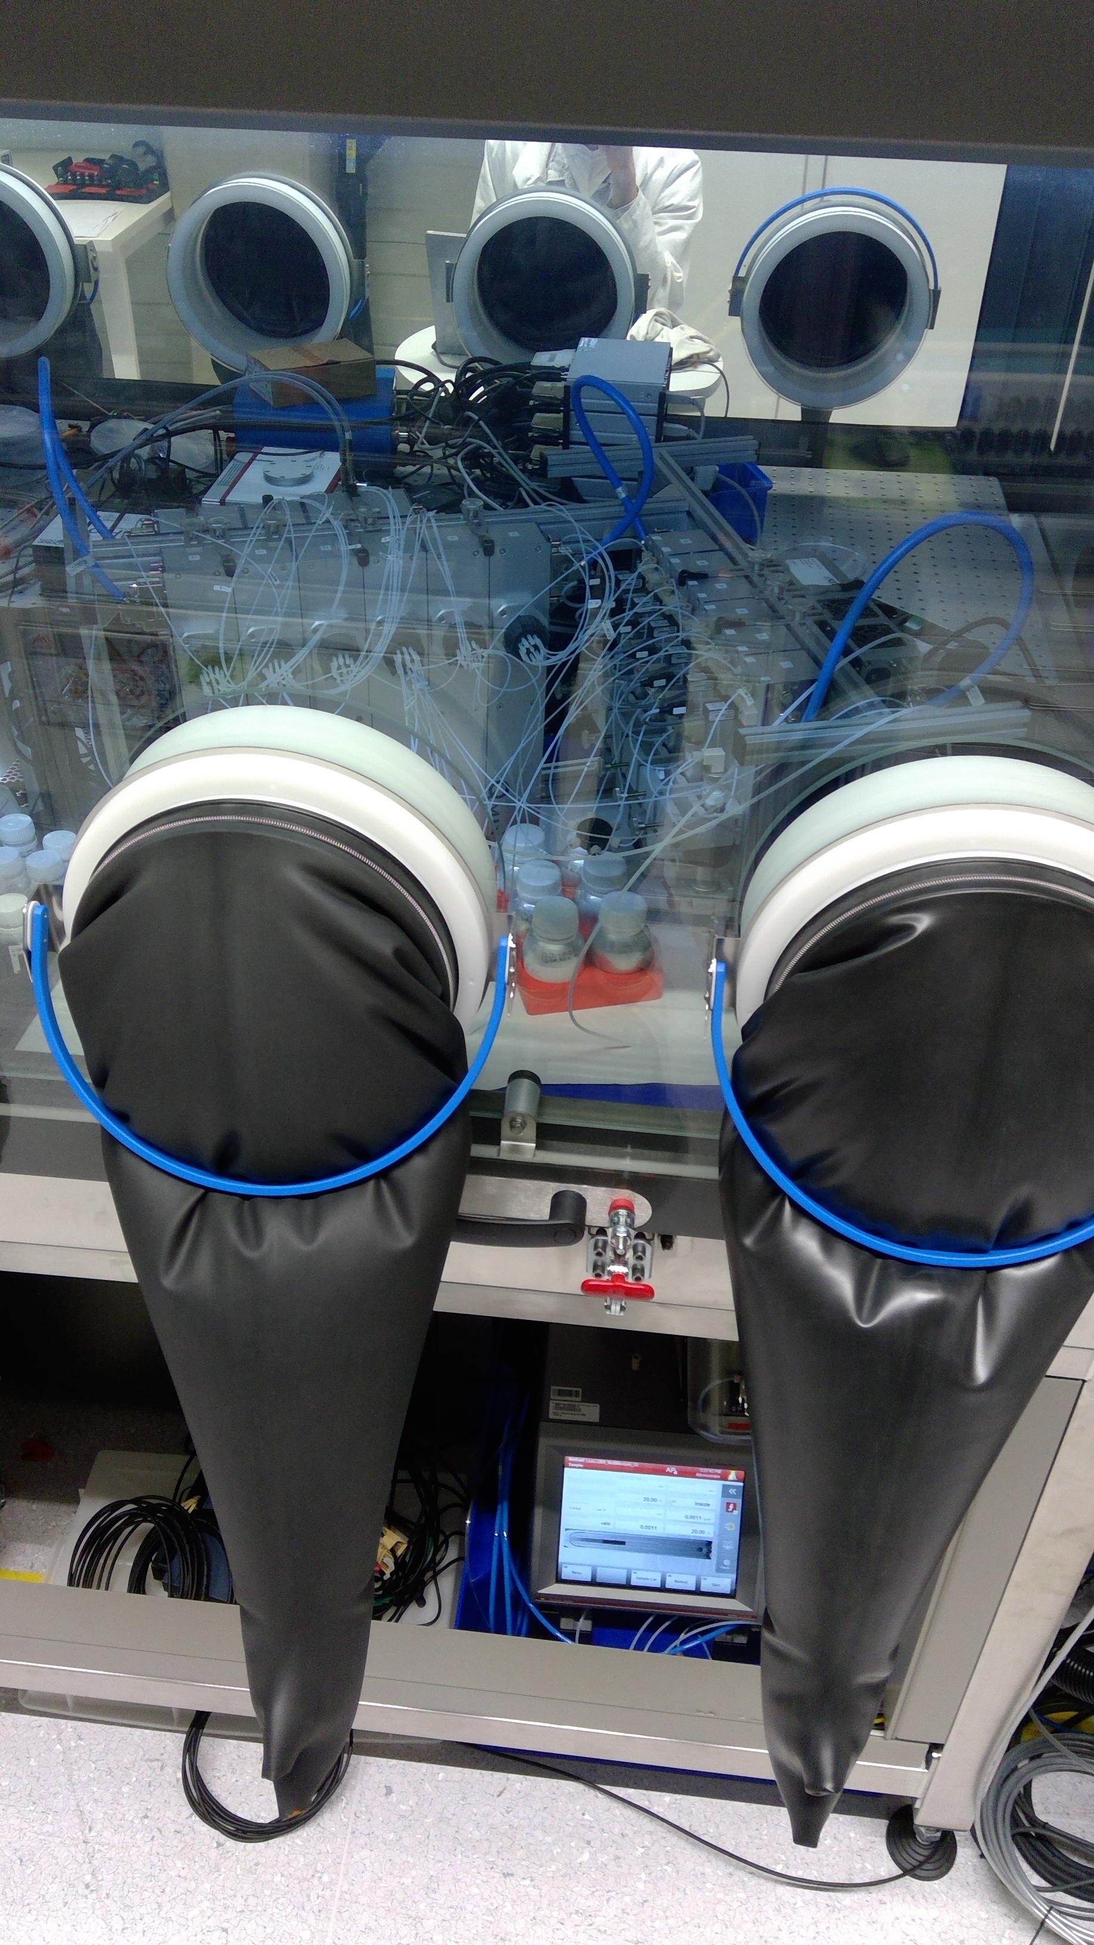
Highlights of the work: WP9, WP10, WP11 Hackathon
(KIT, DTU, 3DS, EPFL)
formulate
measure

Slide 16
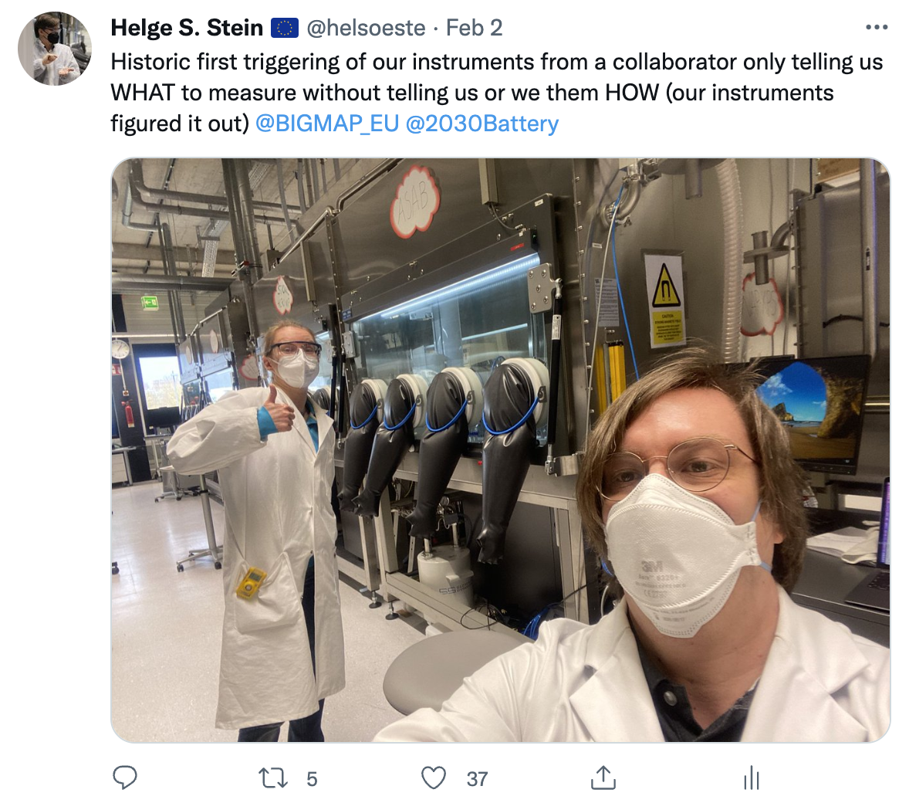
Highlights of the work: WP9, WP10, WP11 Hackathon
(KIT, DTU, 3DS, EPFL)
formulate
measure

Slide 17
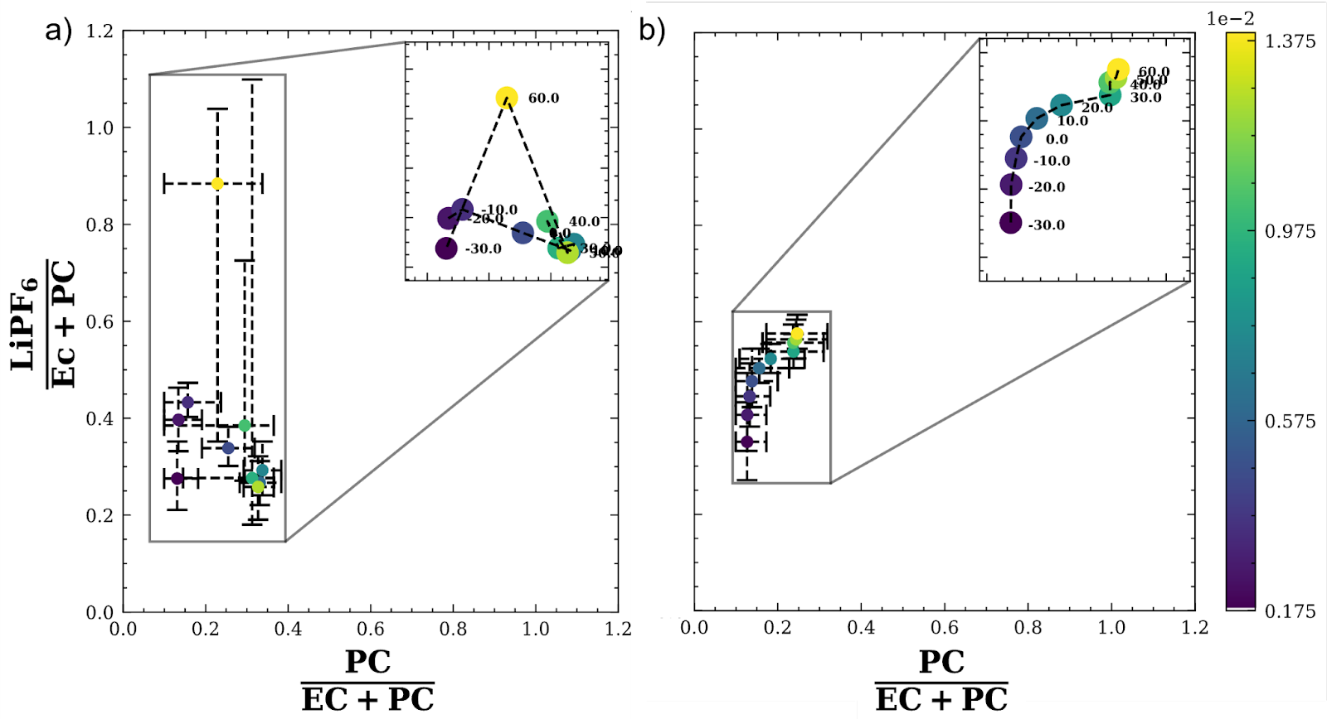
Highlights of the work: Deployment of AL

Slide 18
Highlights of the work: Deployment of AL

Slide 19
Highlights of the work: Deployment of AL

Slide 20
Highlights of the work

Slide 21
Highlights of the work
ML4Chem
Materials Intelligence
Early
Demos
HTS
Workflow Complexity

Slide 22

Highlights of the work: Modular Data Analysis Package

Slide 23
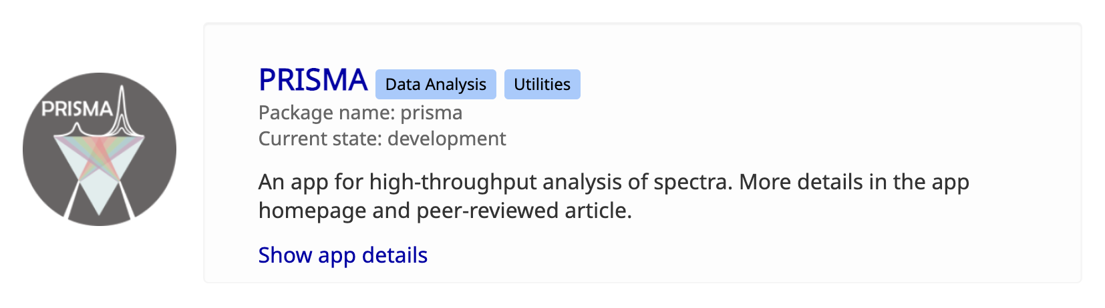
Highlights of the work: Modular Data Analysis Package

Slide 24
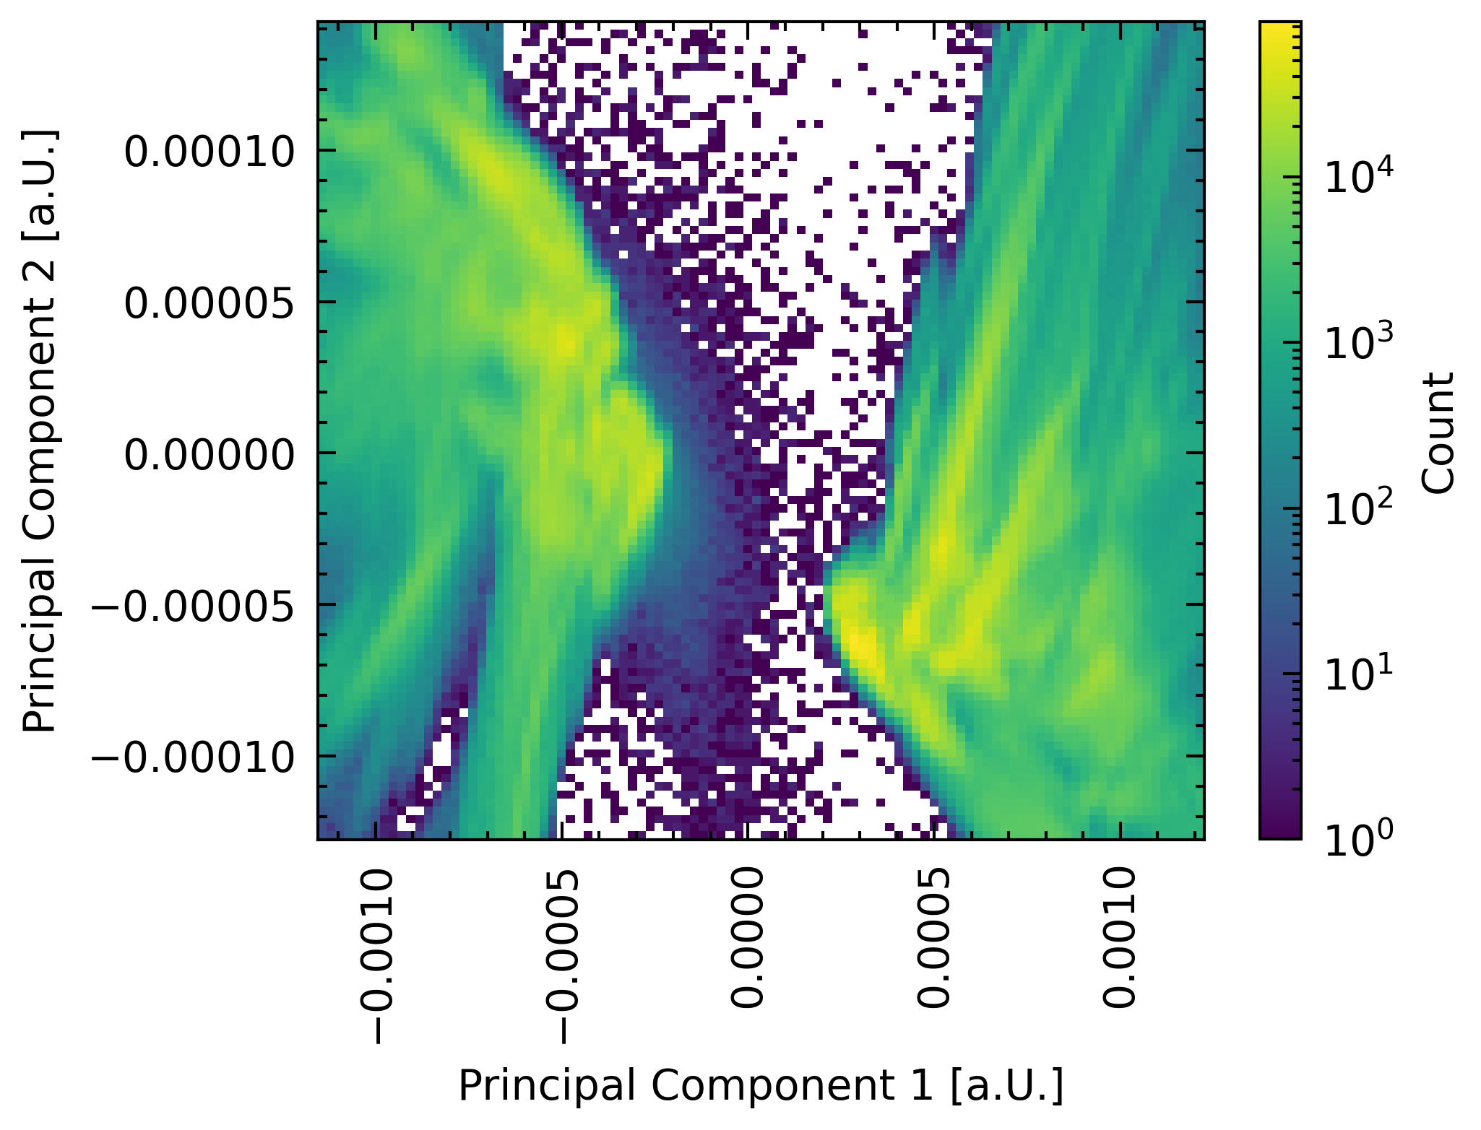
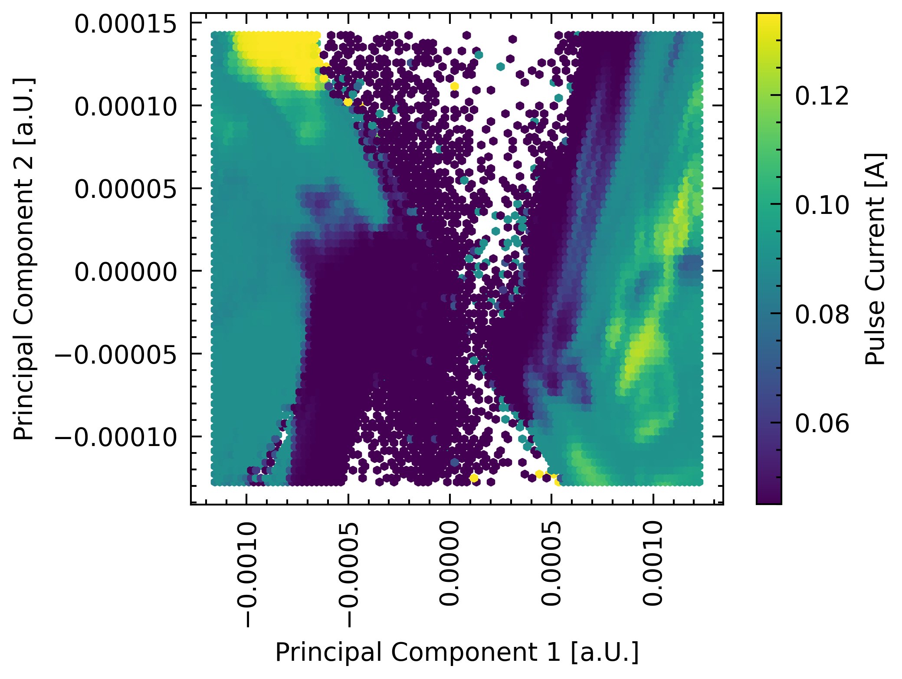
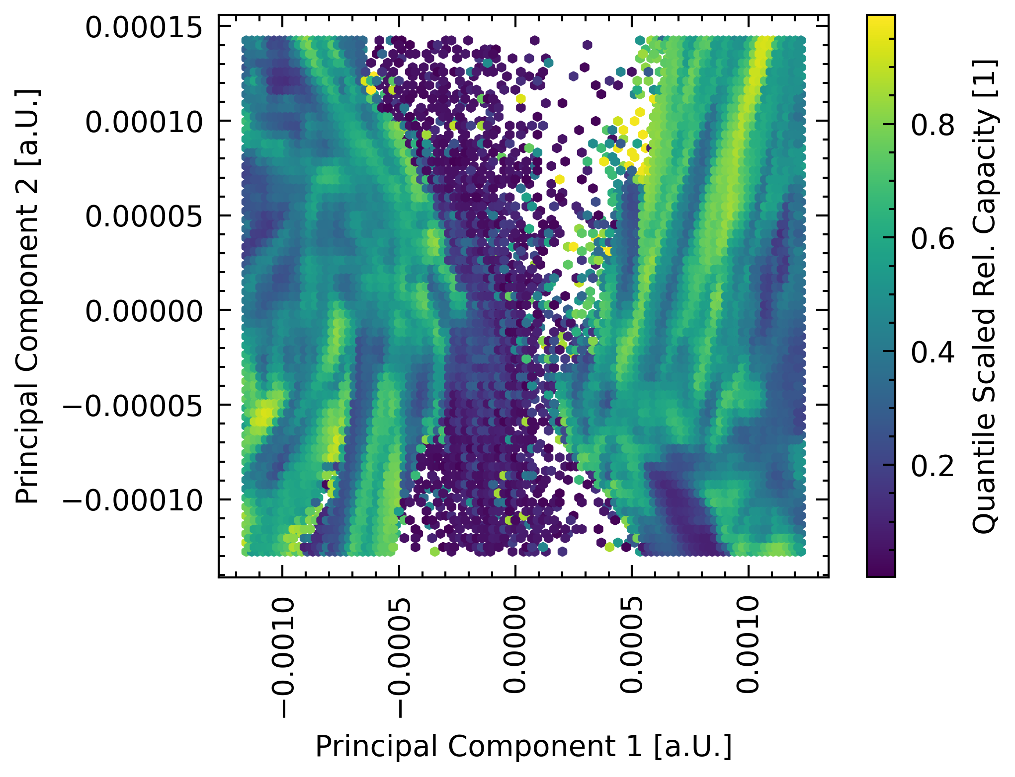
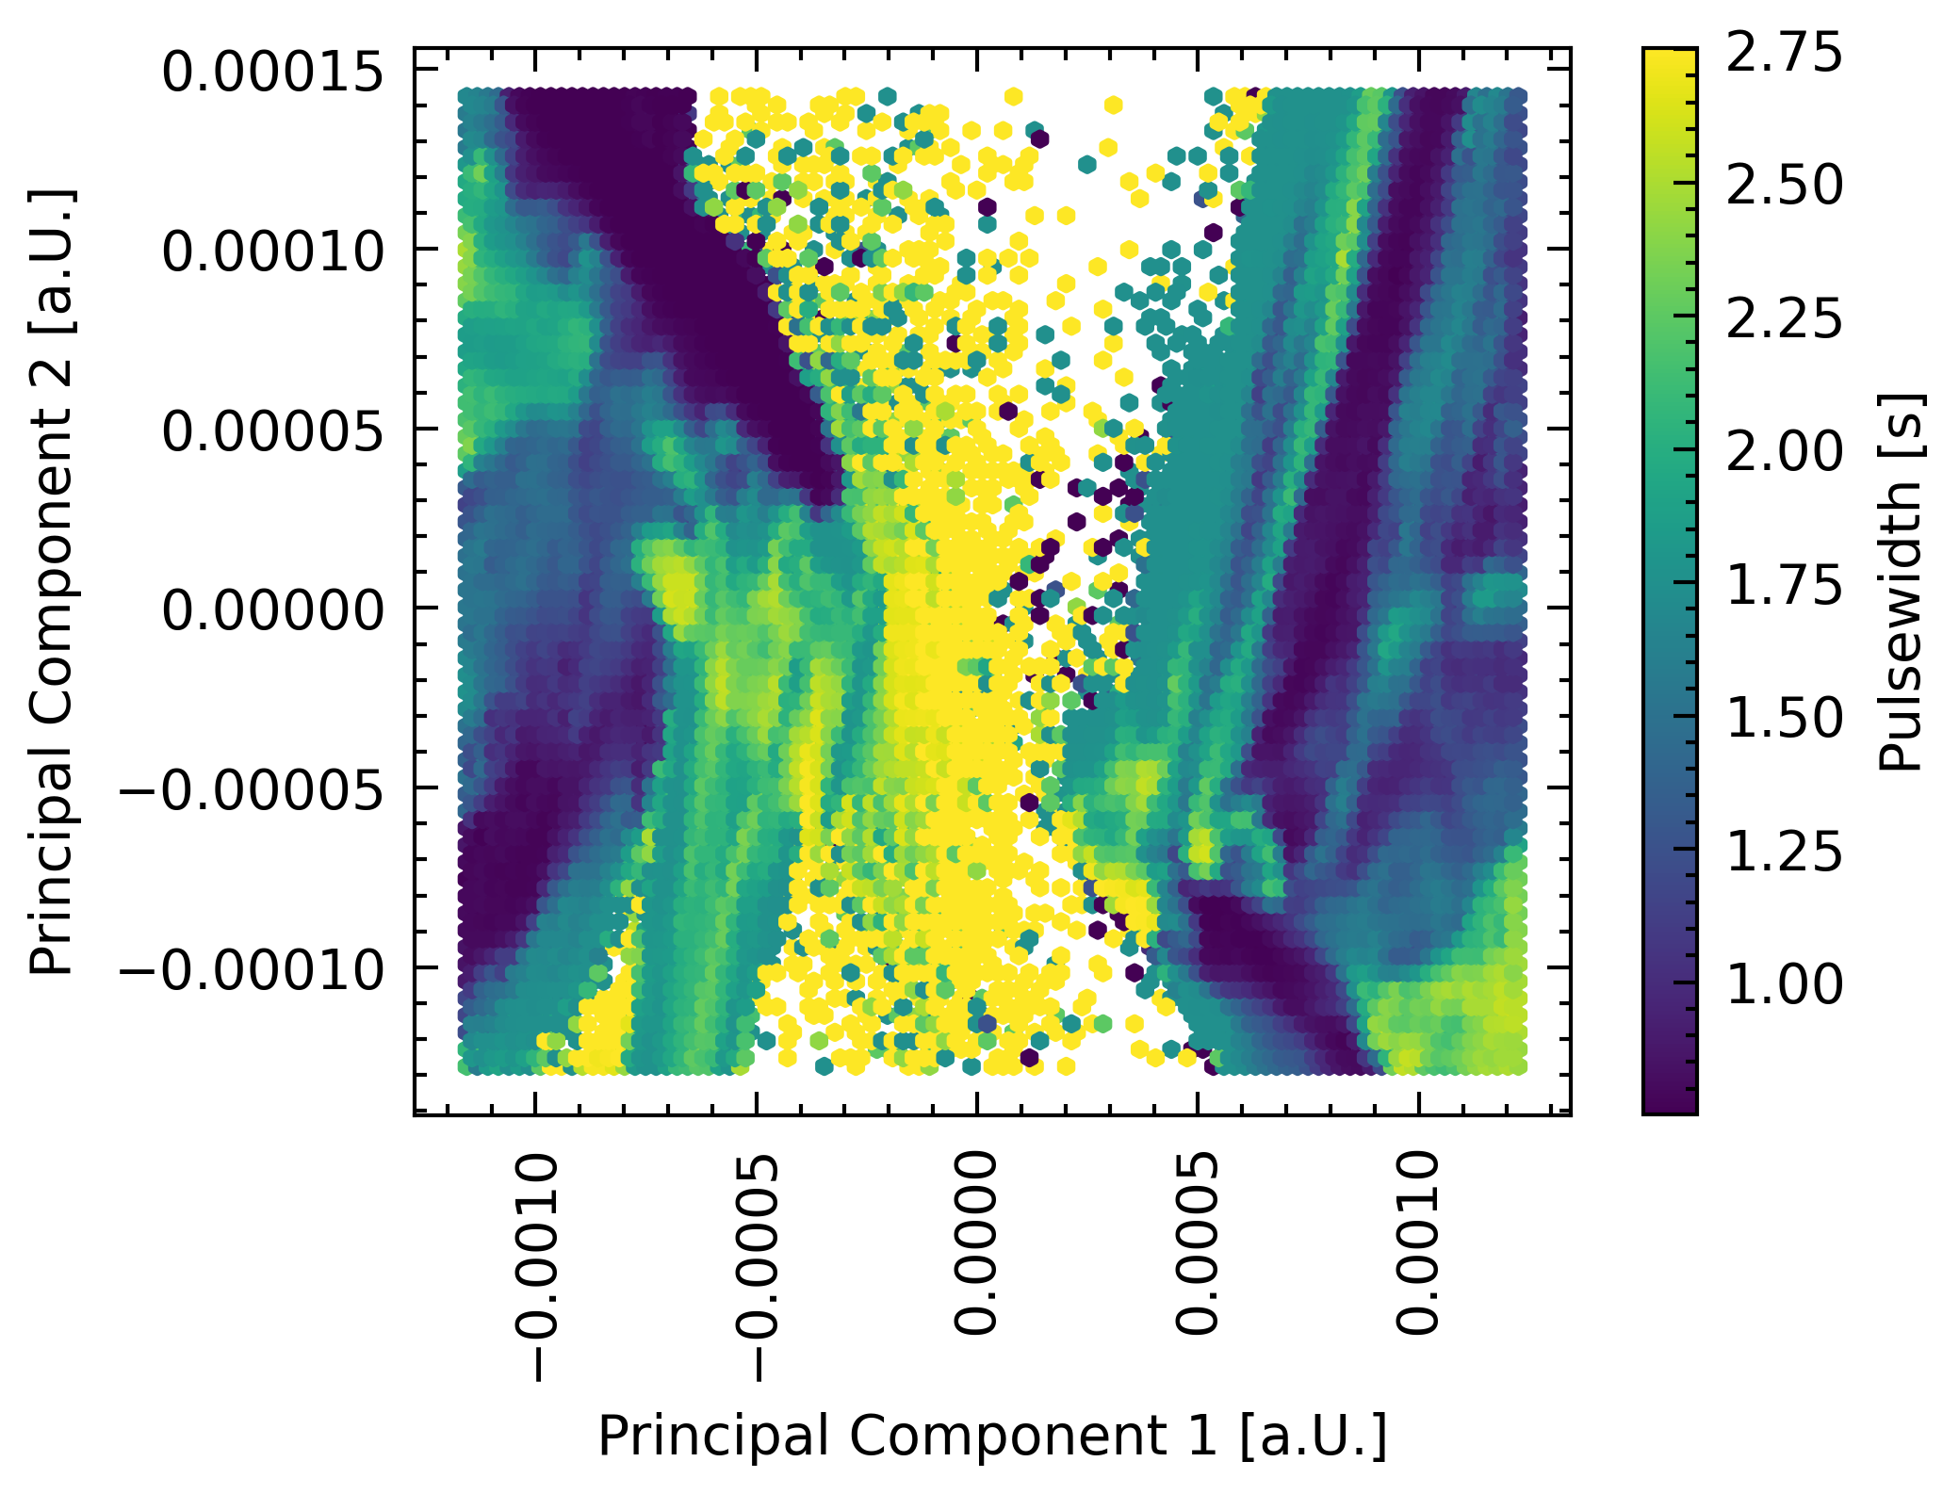
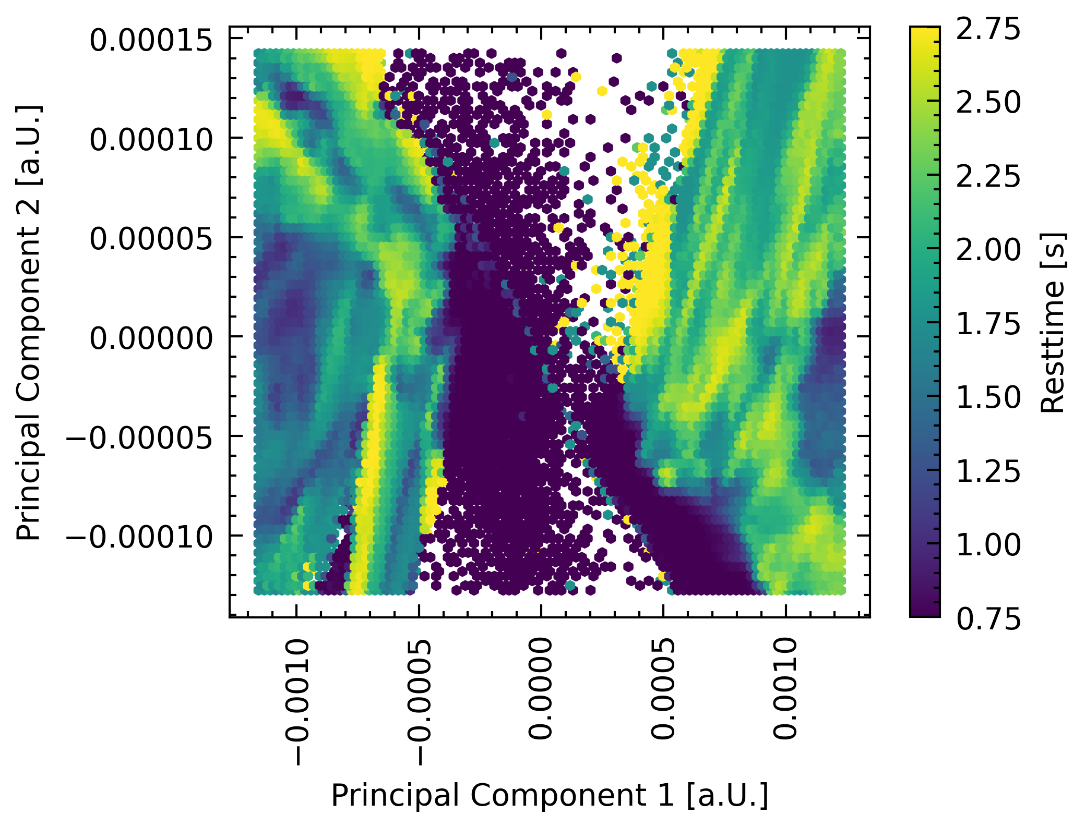
Highlights of the work: Extension for electrochemistry

Slide 25
Highlights of the work: Extension for electrochemistry
GITT analysis
(CIDETEC,ULIV,KIT)
EIS analysis (KIT)
Standart battery analyses (ULIV, KIT)
XPS/SIMS (KIT)

Slide 26
Accelerating experiments with active learning
An automated data analysis framework
WP4,WP5, WP6
WP4,WP5, WP6
WP11, WP2, WP3, WP4,WP5, WP6
WP2, WP3, WP4, WP5, WP6, WP11
Transfer learning and new fundamental insights
Automatic reasoning and materials funnel
D10.1: Active learning Package/Module (KIT, M18) D10.2: Modular package for analysis (ULIV, M24)
D10.3: Demonstration of linking active learning accelerated HTS and simulations (DTU, M24) D10.4: Tiered theory and experiment screening pipeline (KIT, M36)

Slide 27
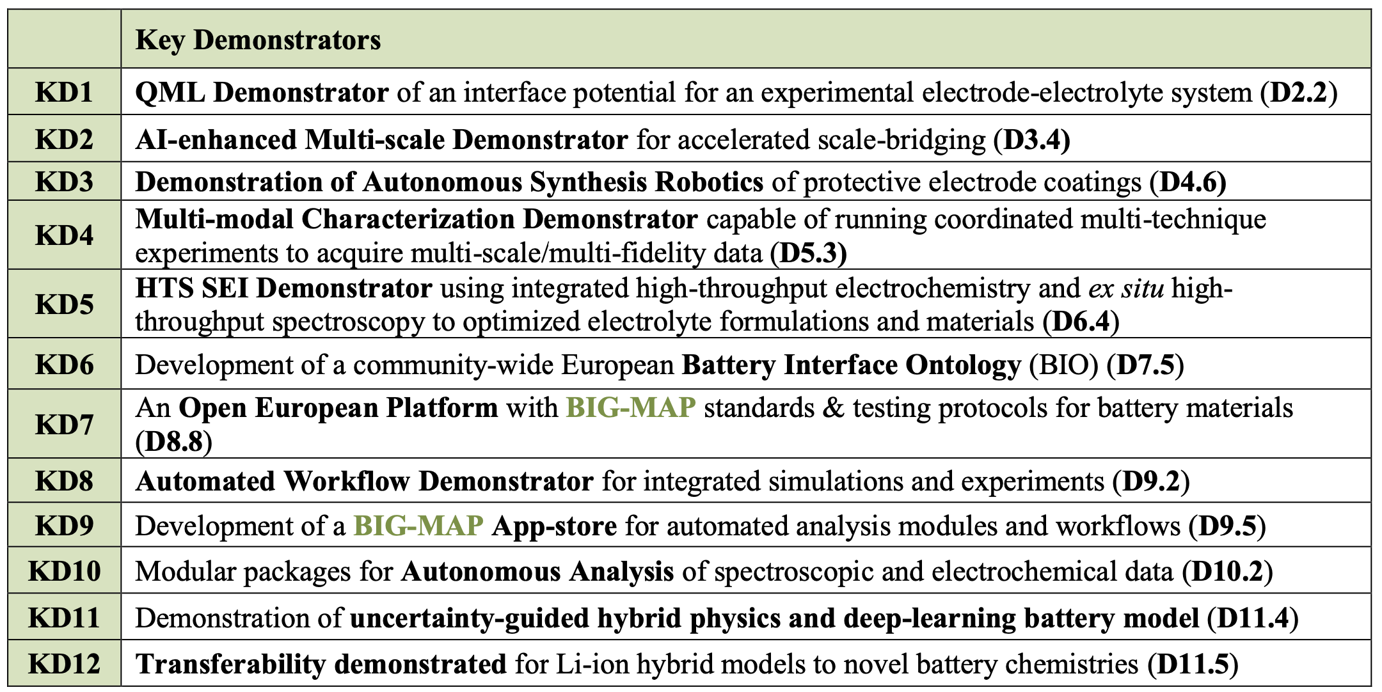
Key Demonstrators

Slide 28
Interaction with Battery2030+
Started building the tools to (partially) accelerate virtually any project under the Battery2030+ umbrella!
Intention
Experiment
Participated in the workshops
Co-drafted the roadmap and made amendments
Joined effords for standartization
Acknowledgement

Slide 29
Outlook
objective
fidelity
cost
tenancy
…
optimization
learning
collaboration
…
multi

